Slide 1
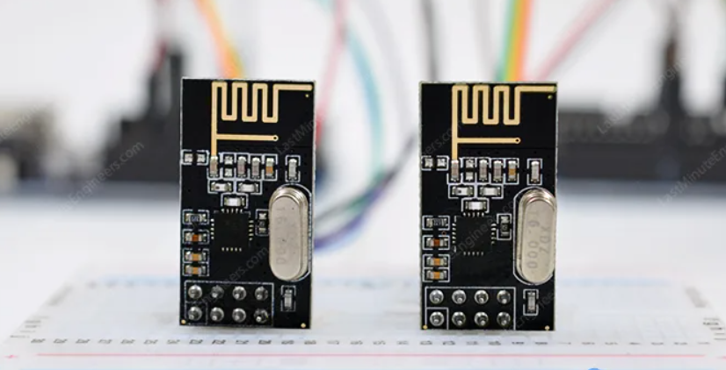
NRF24L01 module

Slide 2
Why NRF Module?
1-transceiver module
2-The nRF24L01 module is available for less than two dollars
3-uses GFSK modulation for data transmission
4-The data transfer rate is configurable and 5-can be set to 250kbps, 1Mbps, or 2Mbps
6-voltage ranges from 1.9 to 3.9V
7-the module consumes only 12 mA during transmission
8-And the best part is that it consumes only 26 µA in standby mode and 900 nA in power down mode.
9-Communication Range800+ m (line of sight)

Slide 3
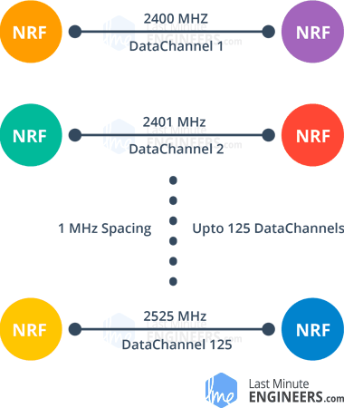
Immunity Against Interference
Operate on 2.4 GHZ To 2.525 GHZ
We have a 125 available cahnnel

Slide 4
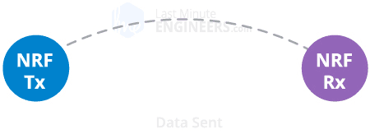
nRF24L01+ Automatic Packet Handling

Slide 5
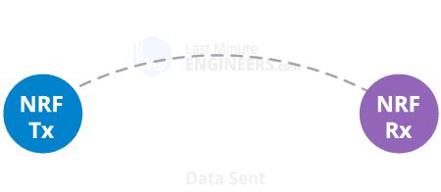
nRF24L01+ Automatic Packet Handling

Slide 6

nRF24L01+ Automatic Packet Handling

Slide 7
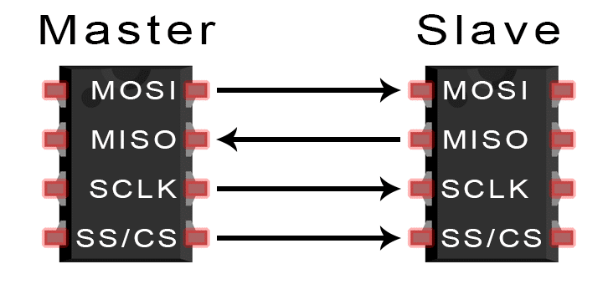
How stm32 communicate with Nrf Module?
SPI communication protocol

Slide 8
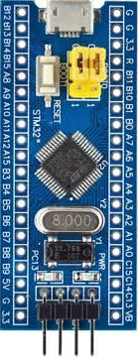
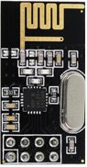
Stm32 is the master
Nrf is the slave
MOSI
MISO
CLK
CS

Slide 9
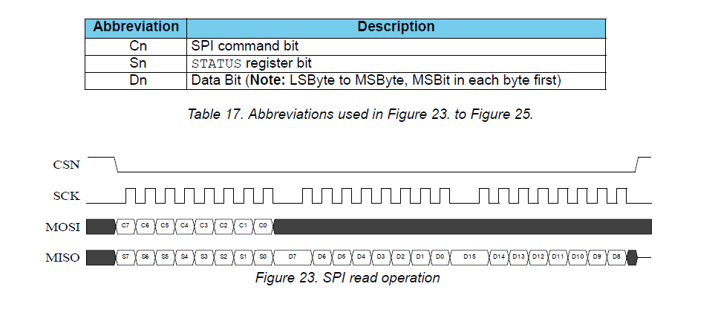
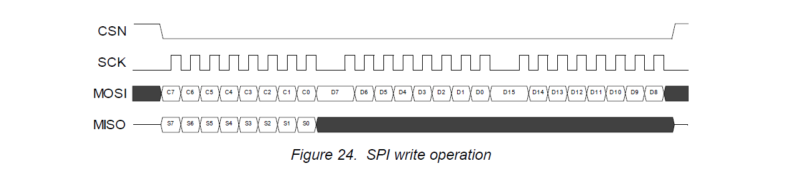
How STM32 Tell Nrf To Transmit Or Receive A Message?

Slide 10
